Slide 1
Exceptional Families: Exceptional Needs
Creating Awareness of
Members with Disabilities
in our Church Family
Presented by (add presenter’s name here)
Written by
Willie Oliver, PhD CFLE
Elaine Oliver, MA, CFLE
Luana Greulich, PhD

Slide 2
Important facts
Approximately 10% of the world’s population (650 million people) live with a disability
A disability can be classified as a mobility, hearing or visual impairment, speech limitations or mental impairment (Kaufman, Scarborough and Baker, 2005)
Some disabilities are not visible or easily detected such as hearing and visual impairment and those on the autism spectrum

Slide 3
Why is this important to the Church Family?
People with disabilities form part of our congregations
People with disabilities are part of our communities
They need acceptance and Jesus
They have a story to share
The Church family needs to know how to accommodate individuals with disabilities

Slide 4
13 Categories of Disabilities
Low Incidence
High Incidence
Blindness
Deaf and Hard of Hearing
Multiple Disabilities
Orthopedic Impairment
Other Health Impairments
Traumatic Brain Injury
Visual Impairments
Autism
Emotional Impairment
Specific Learning Disability
Speech or Language Impairment
Intellectual Disability/Cognitive Impairment

Slide 5
Walking in exceptional shoes Activity for Language Impairment or Learning Disabilities
Write your name in cursive for 1 min
Now switch and write your name for 1 min with the opposite hand
How many times did you write your name legibly?
Now look at the next slide and read the words on the slide, now read them as fast as possible
Now look at the same slide and read the color that the word is written in

Slide 6
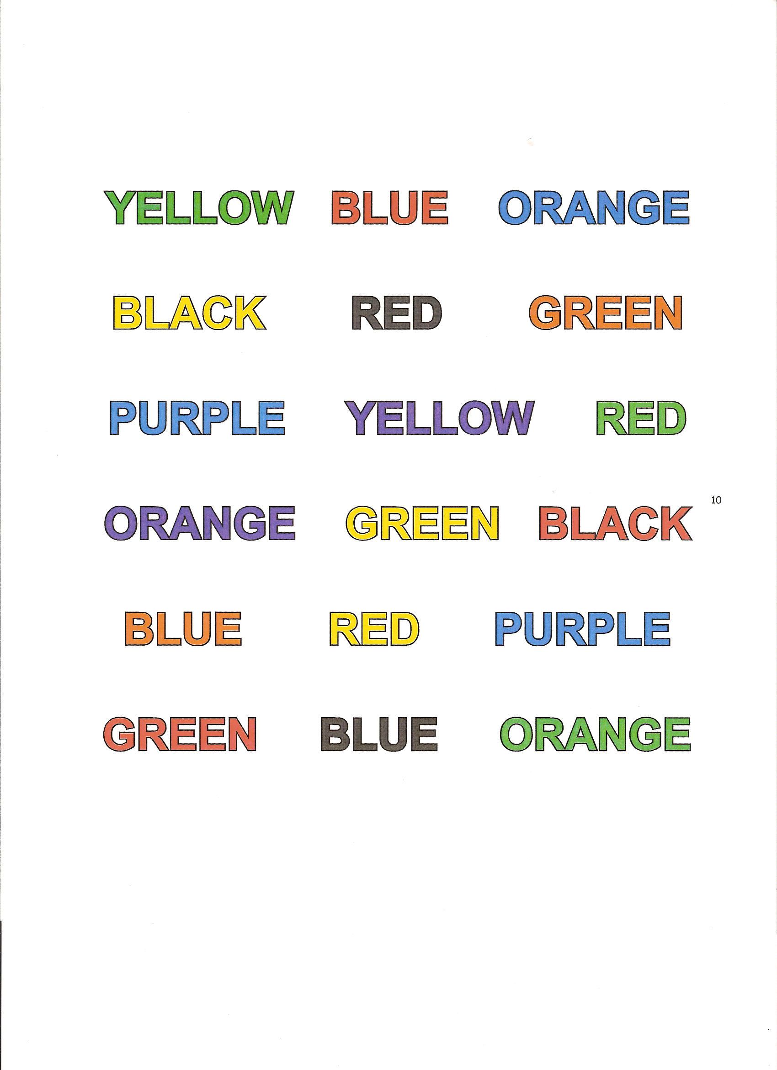
Notes:
RC: please contact Dr. Greulich luana@andrews.edu and ask her if she can give a brief explanation as to how to debrief the language impairment and learning disabilities activity – what prompts can she give to help participants learn from this acitivity.

Slide 7
Activity for Hearing Impairment Small Group Activity (10-15 minutes)
“Can You Hear Me Now?”
Materials Needed: Ear plugs, Note cards, Pencils/Pens
Participants put earplugs in ears
Facilitator reads a list of 10 words
Participants write the words they hear on their cards
Debrief: Participants share how they felt and what they experienced during the activity. Imagine how someone who is hearing impaired may feel during the worship service.

Slide 8
What do we know about working with individuals with disabilities?
Several disabilities encompass a lack of social skills
Learning Disabilities
Autism
ADHD
Emotional Impairments
Hearing Impairments
Cognitive Impairments

Slide 9
What do we know about working with individuals with disabilities?
They communicate differently
They learn differently
They see things differently
They cope differently
Be careful
Expectations are everything-just because individuals have a disability does not mean that they are disabled.

Slide 10
What does coping look like and what can we do?
Looks Like
We Can
Flapping hands
Rocking
Isolating self
Verbal soothing
Tactile soothing
No eye contact
No touch
Provide less stimulation
A quiet place
A plan
Soothing voice
Not be afraid
Educate ourselves

Slide 11
And behold, some men were bringing on a bed a man who was paralyzed, and they were seeking to bring him in and lay him before Jesus, but finding no way to bring him in, because of the crowd, they went up on the roof and let him down with his bed through the tiles into the midst before Jesus. Luke 5: 18, 19
“
In this Bible story we see men finding a way to bring a paralyzed man to hear Jesus’ messages of hope
They were aware of this man’s needs
They had compassion and concern towards the man
We see incredible faith being displayed on the part of the men and the paralytic man

Slide 12
Moving Beyond Compassion
As disciples of Jesus, the evidence of our faith is seen in our works – in our love for one another
We need to become aware of our similarities and differences
Have compassion for members with disabilities within our church family
We need to move from compassion to finding ways to minister to their needs

Slide 13
Moving Beyond Compassion
How do we move beyond compassion and become more inclusive of all in the church family?
By following Jesus’ example of ministering to the disabled
He noticed them, prayed for them and ministered to them
Compassion does not mean pitying or feeling sorry for the other person
Compassion is to feel empathy for another person dealing with challenges
It is to feel a deep desire to help alleviate their suffering
Let’s visualize a framework of moving from awareness, to compassion, to ministry/family inclusion
AWARENESS
COMPASSION
MINISTRY/
FAMILY
INCLUSION

Slide 14
Moving Beyond Compassion
Ellen White says in Acts of the Apostles:
Divine love makes its most touching appeals to the heart when it calls upon us to manifest the same tender compassion that Christ manifested.
Once we become aware, and show compassion we need to transition into ways in which we can accommodate members with disabilities in the family to meet their needs
AWARENESS
COMPASSION
MINISTRY/
FAMILY
INCLUSION

Slide 15
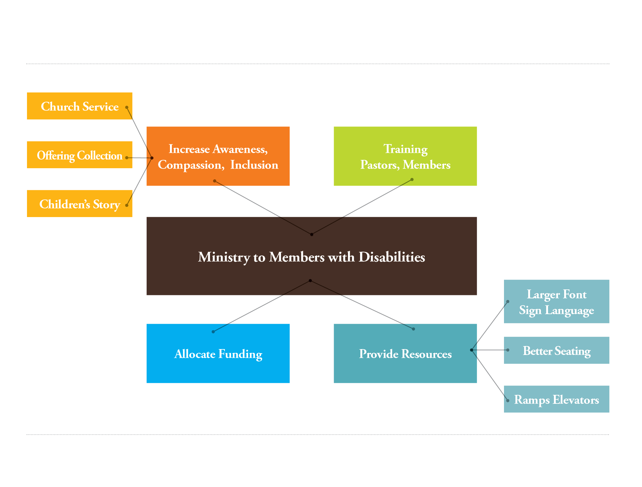
Ministry to Members with Disabilities This illustration is a mind map that can serve as a launch pad for ministry to members with disabilities and their families

Slide 16
Individuals with Disabilities
Michael Naranjo- “I have no time to be disabled I am too busy creating my works of art”-he is a sculptor with visual impairment
Troy- Over a thousand Bible studies from his wheelchair
Robbie-Preaches his love for God
Ouchie-Testimony and baptism on how God has helped him-witnesses to all around him
They too want to glorify God with their lives and
want to serve Him

Slide 17
Where do we go from here?
Divide participants into groups of 8-10
Select a spokesperson for the group
Refer to the mind map (slide 15)
Each group will brainstorm about what else could be added to the mind map. What changes or additions are needed in order to minister to the needs of members with disabilities?
What does the church need to do better?
Debrief with the entire group. Have each group spokesperson share ideas from their group.
Willie Oliver, PhD, CFLE and Elaine Oliver, MA, CFLE are Directors of the Department of Family Ministries at the General Conference of Seventh-day Adventists World Headquarters in Silver Spring, Maryland, USA.
Luana Greulich, PhD, is Associate Professor and Special Education Program Coordinator at Andrews University in Berrien Springs, Michigan, USA.

